Slide 1


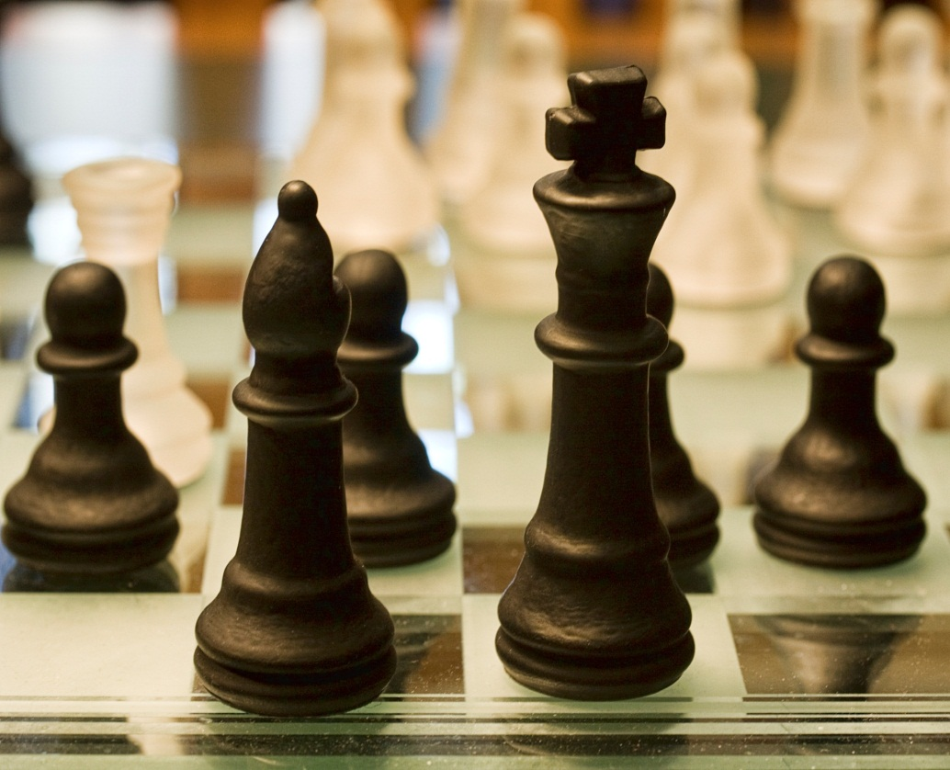
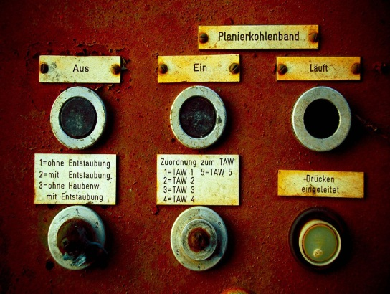
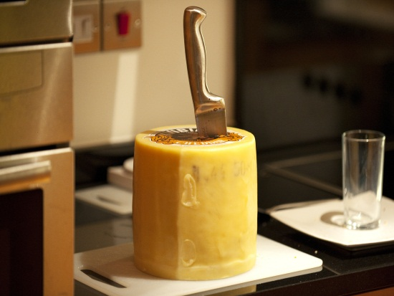
The Evolution of Patterns Influences and Examples of Emerging Patterns Chris Eargle

Slide 2

Chris Eargle
Telerik Developer Evangelist
INETA Director
Microsoft MVP – Visual C#
MCPD, MCTS, etc
kodefuguru.com
kodefuguru@live.com

Slide 3
What is a Pattern?
An element of reusable software
Names, motivates, and explains a general design that addresses recurring design problems
Describes the problem, the solution, when to apply the solution, and its consequences

Slide 4
Implementation Levels
Invisible Part of the language
Informal Referred to by name, but must be re- implemented for each use
Formal Implement pattern itself within the language
Notes:
These three levels are from Peter Norvig’s articles in Object World.

Slide 5
Influences
Language Features
Innovations in Object-Oriented Design
Other Programming Paradigms

Slide 6
Language
Design patterns may be a sign of missing language features

Slide 7
“16 of 23 patterns have qualitatively simpler implementation in Lisp or Dylan than in C++ for at least some uses of each pattern.”
Peter Norvig

Slide 8
Language Features
Keywords are added to languages
Typically streamlines a process
May be tied to other paradigms

Slide 9
Innovations
Object-Oriented Programming is mature
Sometimes an idea takes hold…
challenges OO Principles…
and takes the community by storm.

Slide 10
Fluent Interfaces
Utilizes method chaining
Defined through the return value of a called method
Self referential - the new context is equivalent to the last context

Slide 11
Fluent Interfaces
English-readable, left-to-right code
May violate command-query separation with stateful objects
Terminated through the return of a void context

Slide 12
Paradigms
There is a huge ecosystem of programming languages
Most languages fall into categories other than OO
These slowly make their way into modern OO languages

Slide 13
Generic
Algorithms use types to be specified later
Reduces duplication
Pioneered by ADA in 1983
May be harder to understand
Notes:
generic programming is a style of computer programming in which algorithms are written in terms of to-be-specified-later types that are then instantiated when needed for specific types provided as parameters. This approach, pioneered by Ada in 1983, permits writing common functions or types that differ only in the set of types on which they operate when used, thus reducing duplication. The Gang of Four noted that this technique, especially when combined with delegation, is very powerful but that "[dynamic], highly parameterized software is harder to understand than more static software."^{[1]}

Slide 14
Terminology
Generics
Ada, Eiffel, Java, C#, F#, and Visual Basic .NET
Parametric Polymorphism
ML, Scala and Haskell
Templates
C++

Slide 15
Functional
Treats computation as the evaluation of functions
Avoids state and mutable data
Roots in lambda calculus

Slide 16
Terminology
first class functions
functions can be passed as arguments
higher-order functions
take one or more functions as input
or outputs a function
combinators
takes one or more functions as input
and outputs a function

Slide 17
“a combinator is a function which builds program fragments from program fragments…”
John Hughes

Slide 18
Terminology
pure functions
no side effects, which means the function called with the same arguments returns the same result
anonymous functions
a function defined, and possibly called, without being bound to an identifier.
continuation-passing style
when a function is complete, the computation is passed to a continuation function

Slide 19

Singleton

Slide 20
Singleton Pattern
Restricts class instantiation to one instance
Useful when only one instance is needed in system
Some consider this an anti-pattern
Not the same as a static class

Slide 21
Singleton Diagram
- Singleton()
S+ Instance
Singleton <<singleton>>
Retrieves a single, maintained instance of class.

Slide 22
Influence on Language
A few modern languages directly implement this construct

Slide 23
Scala Example
// Singleton uses the object keyword instead of class
object Utilities {
val test = "Test App"
def loadImages() = {
// ...
}
def createManager():EntityManager = {
// ...
}
}

Slide 24

Lazy Initialization

Slide 25
Lazy Initialization
Delays creation of an object
Use when eager initialization is resource intensive
Often used with a factory method (more later)

Slide 26

Iterator

Slide 27
Iterator Pattern
iterator an object that provides a standard way to examine all element of any collection.
Has a uniform interface for traversing many data structure without exposing their implementations.
Supports concurrent iteration and element removal.
No need to know the internal structure of collection.

Slide 28
Iterator Diagram
+ First()
+ Next()
+ IsDone()
+ CurrentItem
+ CreateIterator()
Iterator <<interface>>
Aggregate <<interface>>
Client
+ CreateIterator()
ConcreteAggregate
ConcreteIterator

Slide 29

Command

Slide 30
Command Pattern
used to represent and encapsulate all the information needed to call a method at a later time

Slide 31
Terminology
client
instantiates the command object and provides the information required to call the method at a later time.
invoker
decides when the method should be called
receiver
instance of the class that contains the method's code

Slide 32
Command Diagram
Client
+ Execute()
Command <<interface>>
Invoker
+ Action()
Receiver
+ Execute()
ConcreteCommand

Slide 33
Fluent Command
The Execute method return the object
Enables quick access to return properties
command.Execute();
var results = command.Results;
var results = command.Execute() .Results;

Slide 34
Delegate Command
Execute is accepted as a function

Slide 35
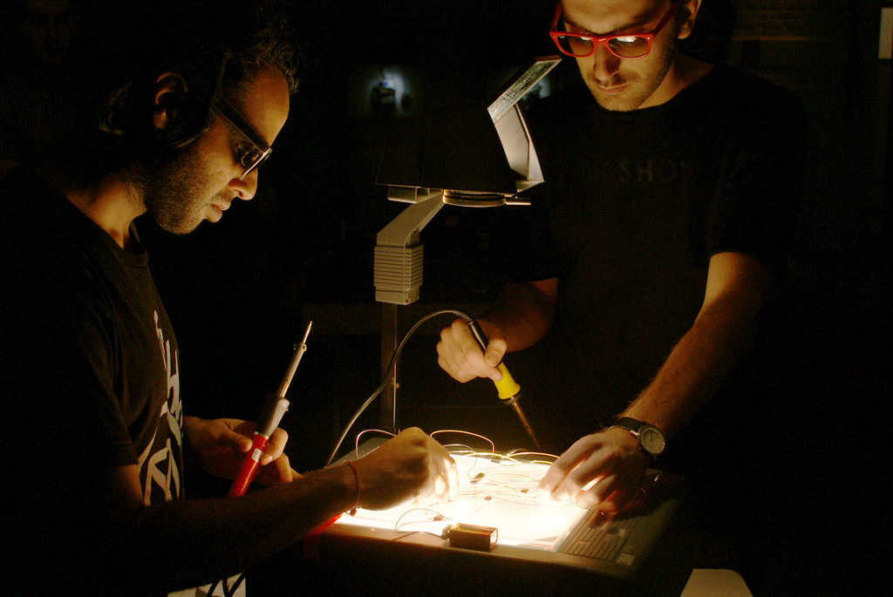
Factory

Slide 36
Factory Method
Method used to create an object
Used when it is more complex to simply instantiate
Don’t confuse this with abstract factory, a generalized pattern for building a series of factories
Useful in C# to take advantage of generic inference

Slide 37
Function Factory
Combinators correspond to factory methods for functions

Slide 38
Factory Function
Utilizes a function to create an object

Slide 39

Strategy

Slide 40
Strategy Pattern
Defines family of algorithms
Encapsulates algorithms to make them interchangeable

Slide 41
Strategy Diagram
AlgorithmInterface()
Containment
Strategy <<interface>>
ContextInterface()
Context
Use
<<implements>>
<<implements>>
AlgorithmInterface()
ConcreteStrategyA <<implementation>>
AlgorithmInterface()
ConcreteStrategyB <<implementation>>

Slide 42
Function Strategy
When a strategy is required, allow owner to pass in a function
Prevents class explosion
Enables flexibility

Slide 43
Function Strategy
Containment
Strategy <<delegate>>
ContextInterface()
Context
Use

Slide 44

Template Method

Slide 45
Template Pattern
Defines the program skeleton of an algorithm
Encapsulate what changes and make it abstract
Subclasses implement those steps in the algorithm

Slide 46
Template Diagram
AbstractClass
A+ PrimitiveOperation1()
A+ PrimitiveOperation2 ()
+ TemplateMethod()
+ PrimitiveOperation1()
+ PrimitiveOperation2()
ConcreteClass

Slide 47
Function Template
Encapsulate what changes into functions
Allow owner to specify those pieces of the algorithm
Prevents class explosion

Slide 48
References
Online references and source code can be found at bitly.com/wHIBI0

Slide 49
References
Patterns of Enterprise Application Architecture
-Martin Fowler
Revenge of the Nerds
-Paul Graham
Object World, May 5 1996
-Peter Norvig
Functional thinking: Functional design patterns, Part 1
-Neal Ford
Generalising Monads to Arrows
-John Hughes
Design Patterns: Elements of Reusable Object-Oriented Software
-GoF

